Slide 1
Image restoration using cycle-consistent adversarial networks
Name : Bhavik M Jain
USN : 2GI20EC033

Slide 2
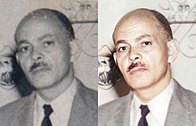
Image Restoration
Image restoration is the operation of taking a corrupt/noisy image and estimating the clean, original image. Corruption may come in many forms such as motion blur, noise and camera mis-focus. Image restoration is performed by reversing the process that blurred the image and such is performed by imaging a point source and use the point source image.

Slide 3
Cycle-Consistent Adversarial Networks (CycleGAN)
Cycle-Consistent Adversarial Networks (CycleGAN) is a deep learning framework that enables unsupervised image-to-image translation between two domains without requiring paired training data. It is particularly effective for tasks such as style transfer, image synthesis, and domain adaptation.

Slide 4
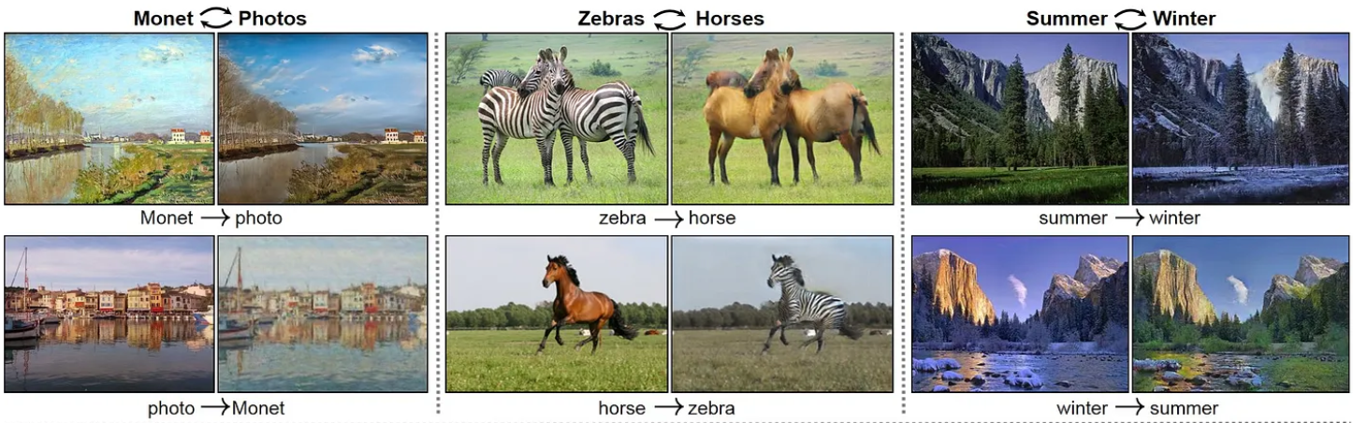

Slide 5
CycleGAN for Image Restoration
CycleGAN can be utilized for image restoration tasks by training it to learn the mapping between degraded images and their corresponding clean versions. This allows the model to restore the original quality of the degraded images.

Slide 6
Steps to apply CycleGAN for image restoration
1) Dataset Preparation: Gather a dataset that consists of pairs of degraded images and their corresponding clean images.
2) Network Architecture: Design the generator and discriminator networks for CycleGAN. The generator should have an encoder-decoder structure, where the encoder encodes the degraded image and the decoder generates the restored image. The discriminator should be able to distinguish between real clean images and generated/restored images.

Slide 7
Cont…..
3) Training: Train the CycleGAN using the collected dataset. The training process involves optimizing the generator and discriminator networks based on adversarial loss and cycle-consistency loss.
a) Adversarial Loss
b) Cycle-Consistency Loss
4) Inference: Once the CycleGAN is trained, it can be used to restore new degraded images. Simply pass the degraded images through the generator to obtain their restored versions.

Slide 8
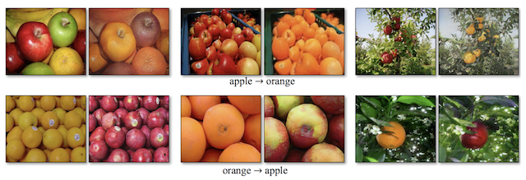

Slide 9
Benefits and Applications
1) The utilization of CycleGAN for image restoration brings several benefits.
2) It offers automatic learning without the need for paired training data, reducing the data collection and annotation efforts.
3) CycleGAN can restore images with improved visual quality, preserving fine details, textures, and structures.
4) Its versatility extends to various applications such as colorization, super-resolution, denoising, and style transfer.

Slide 10
Conclusion
Image restoration using Cycle-Consistent Adversarial Networks (CycleGAN) offers a powerful and versatile approach for transforming images from one domain to another while preserving their underlying structure and content. By leveraging the concept of adversarial training and cycle-consistency, CycleGAN enables unsupervised learning and effective image-to-image translation without the need for paired training data.

Slide 11


